Slide 1

Exploring Wireless Networking
Wireless LANs
© 2007 Cisco Systems, Inc. All rights reserved.
ICND1 v1.0—3-1
The PDF files and any printed representation for this material are the property of Cisco Systems, Inc., for the sole use by Cisco employees for personal study. The files or printed representations may not be used in commercial training, and may not be distributed for purposes other than individual self-study.

Slide 2
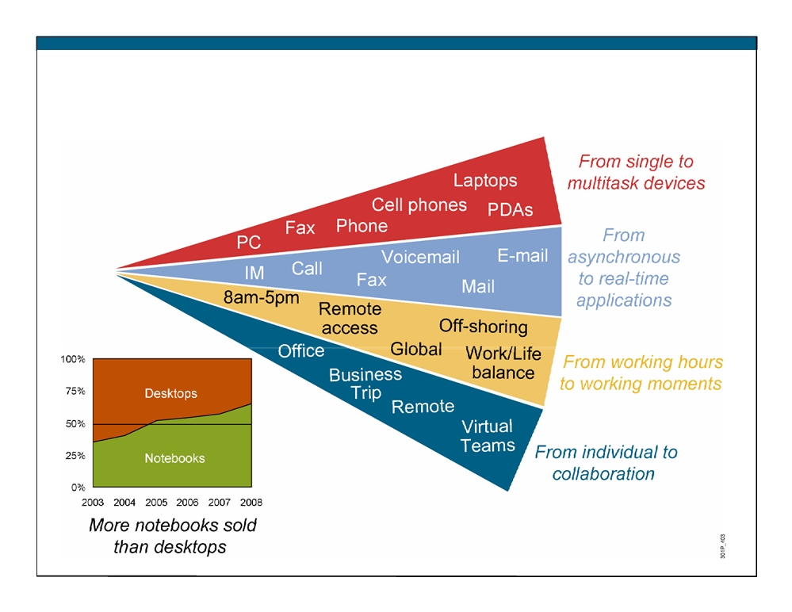
Market Trends
© 2007 Cisco Systems, Inc. All rights reserved.
ICND1 v1.0—3-2
The PDF files and any printed representation for this material are the property of Cisco Systems, Inc., for the sole use by Cisco employees for personal study. The files or printed representations may not be used in commercial training, and may not be distributed for purposes other than individual self-study.

Slide 3

Differences Between WLAN and LAN
ƒ WLANs use radio waves as the physical layer.
WLANs use CSMA/CA instead of CSMA/CD for media access.
- Two-way radio (half-duplex) communication.
ƒ Radio waves have problems that are not found on wires.
- Connectivity issues:
ƒ Coverage problems
ƒ Interference, noise
- Privacy issues
ƒ Access points are shared devices similar to an Ethernet hub for shared bandwidth.
ƒ WLANs must meet country-specific RF regulations.
© 2007 Cisco Systems, Inc. All rights reserved.
ICND1 v1.0—3-3
The PDF files and any printed representation for this material are the property of Cisco Systems, Inc., for the sole use by Cisco employees for personal study. The files or printed representations may not be used in commercial training, and may not be distributed for purposes other than individual self-study.

Slide 4
Radio Frequency Transmission
ƒ Radio frequencies are radiated into the air via an antenna, creating radio waves.
ƒ Objects can affect radio wave propagation resulting in:
- Reflection
Scattering
- Absorption
ƒ Higher frequencies allow higher data rates; however, they have a shorter range.
© 2007 Cisco Systems, Inc. All rights reserved.
ICND1 v1.0—3-4
The PDF files and any printed representation for this material are the property of Cisco Systems, Inc., for the sole use by Cisco employees for personal study. The files or printed representations may not be used in commercial training, and may not be distributed for purposes other than individual self-study.

Slide 5
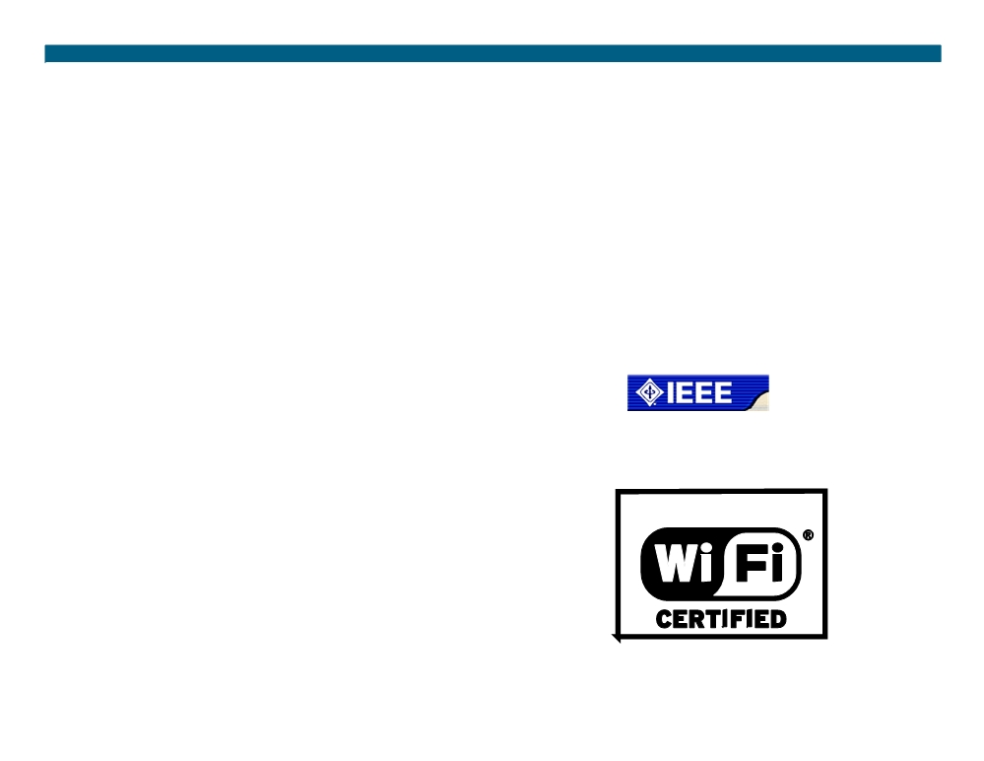
Organizations That Define WLAN
ITU-R:
ƒ International
Telecommunication Union- Radiocommunication Sector
ƒ Regulates the RF used in wireless
IEEE:
ƒ Institute of Electrical and Electronic Engineers
ƒ 802.11 documents wireless technical standards
Wi-Fi Alliance:
ƒ Global nonprofit industry trade association
ƒ Promote wireless growth through interoperability certification
© 2007 Cisco Systems, Inc. All rights reserved.
ICND1 v1.0—3-5
The PDF files and any printed representation for this material are the property of Cisco Systems, Inc., for the sole use by Cisco employees for personal study. The files or printed representations may not be used in commercial training, and may not be distributed for purposes other than individual self-study.

Slide 6
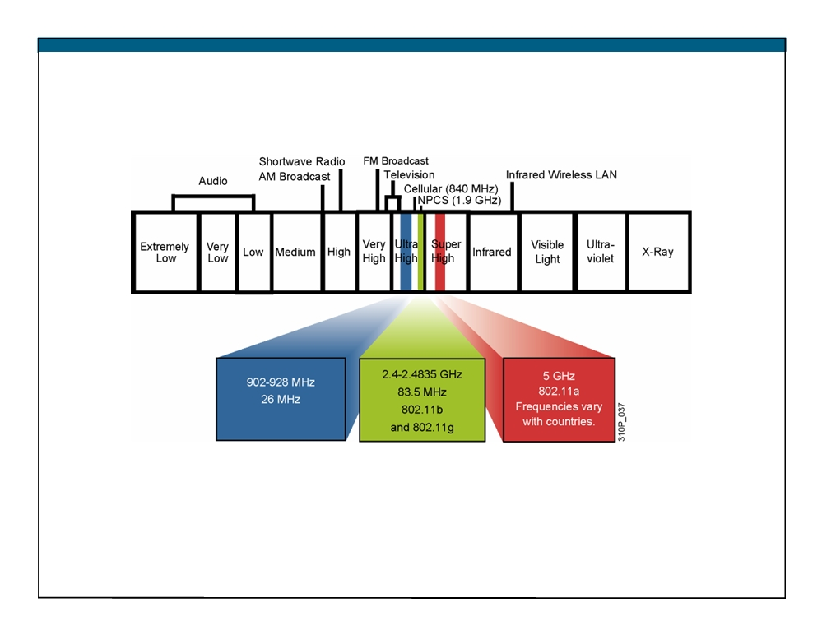
ITU-R with FCC Wireless
ƒ ISM: industry, scientific, and
ƒ Best-effort
medical frequency band
ƒ Interference possible
ƒ No license required
ICND1 v1.0—3-6 The PDF files and any printed representation for this material are the property of Cisco Systems, Inc., for the sole use by Cisco employees for personal study. The files or printed representations may not be used in commercial training, and may not be distributed for purposes other than individual self-study.
© 2007 Cisco Systems, Inc. All rights reserved.

Slide 7
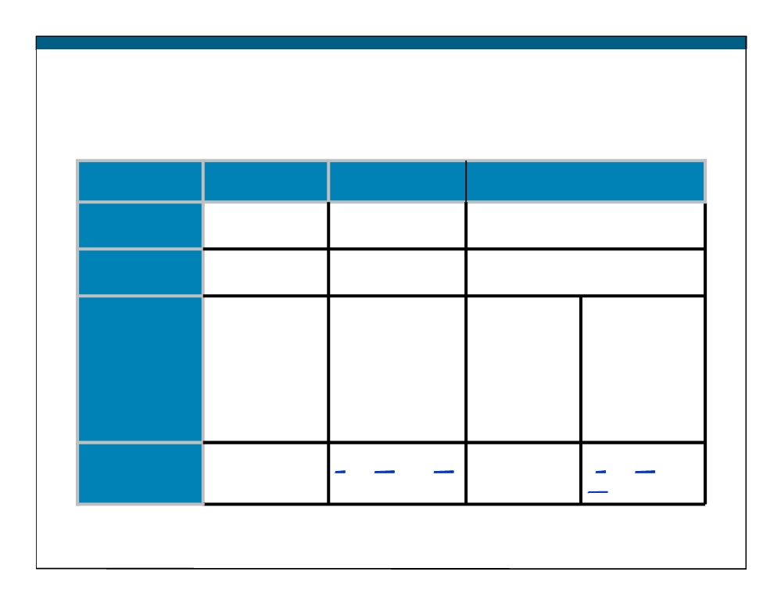
IEEE 802.11 Standards Comparison
802.11b
802.11a
802.11g
Frequency
2.4 GHz
5 GHz
2.4 GHz
band No. of
channels
3
Up to 23
3
Orthogonal
Direct
Orthogonal
Direct
Frequency
Sequence
Frequency
Sequence
Division
Transmission
Spread
Division
Spread
Multiplexing
Spectrum
Multiplexing
Spectrum
(OFDM)
(DSSS)
(OFDM)
(DSSS)
Data rates
1, 2, 5.5, 11
6, 9, 12, 18, 24,
1, 2, 5.5, 11
6, 9, 12, 18,
[Mb/s]
36, 48, 54
24, 36, 48, 54
© 2007 Cisco Systems, Inc. All rights reserved.
ICND1 v1.0—3-7
The PDF files and any printed representation for this material are the property of Cisco Systems, Inc., for the sole use by Cisco employees for personal study. The files or printed representations may not be used in commercial training, and may not be distributed for purposes other than individual self-study.

Slide 8
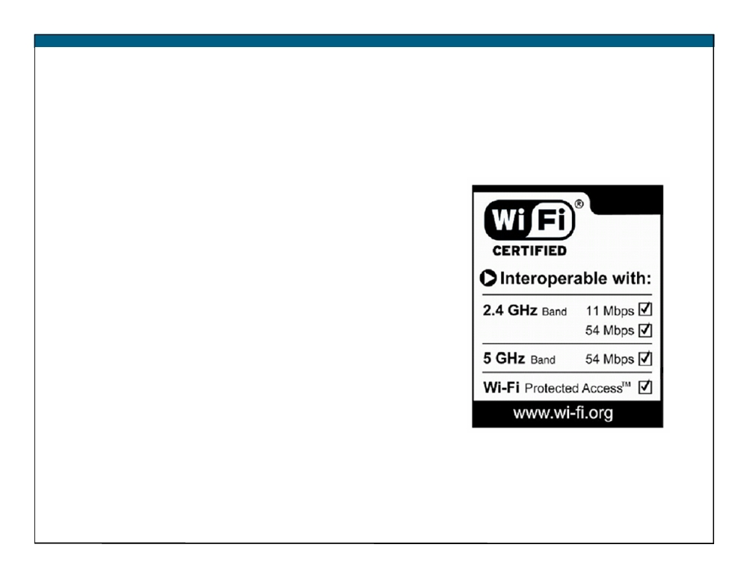
Wi-Fi Certification
Wi-Fi Alliance certifies
interoperability between products.
ƒ Products include 802.11a, 802.11b, 802.11g, dual-band products, and security testing.
ƒ Provides assurance to customers of migration and integration options.
Cisco is a founding member of the Wi-Fi Alliance.
Certified products can be found at
http://www.wi-fi.com.
© 2007 Cisco Systems, Inc. All rights reserved.
ICND1 v1.0—3-8
The PDF files and any printed representation for this material are the property of Cisco Systems, Inc., for the sole use by Cisco employees for personal study. The files or printed representations may not be used in commercial training, and may not be distributed for purposes other than individual self-study.

Slide 9
Summary
ƒ People now expect to be connected at any time and place. However, the most tangible benefit of wireless is the cost reduction.
ƒ Both WLANs and LAN use CSMA. However WLANs use collision avoidance while LANs use collistion detection.
ƒ Radio frequencies are radiated into the air by antennas, where they are affected by reflection, scattering, and absorption.
ƒ The IEEE defines the 802.11 standards.
© 2007 Cisco Systems, Inc. All rights reserved.
ICND1 v1.0—3-9
The PDF files and any printed representation for this material are the property of Cisco Systems, Inc., for the sole use by Cisco employees for personal study. The files or printed representations may not be used in commercial training, and may not be distributed for purposes other than individual self-study.

Slide 10
Summary (Cont.)
ƒ The ITU-R local FCC wireless bands are unlicensed. ƒ The 802.11 standards are a set of standards that define the frequencies and radio bands for WLANs.
ƒ One of the primary benefits of the Wi-Fi Alliance is to ensure interoperability among 802.11 products.
© 2007 Cisco Systems, Inc. All rights reserved.
ICND1 v1.0—3-10
The PDF files and any printed representation for this material are the property of Cisco Systems, Inc., for the sole use by Cisco employees for personal study. The files or printed representations may not be used in commercial training, and may not be distributed for purposes other than individual self-study.

Slide 11
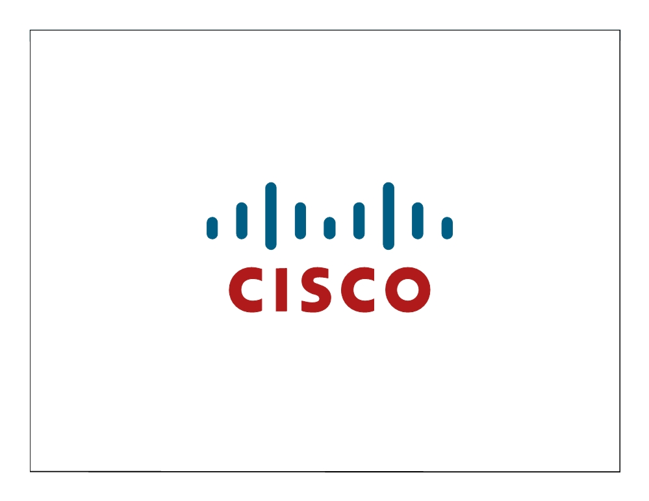
ICND1 v1.0—3-11 The PDF files and any printed representation for this material are the property of Cisco Systems, Inc., for the sole use by Cisco employees for personal study. The files or printed representations may not be used in commercial training, and may not be distributed for purposes other than individual self-study.
© 2007 Cisco Systems, Inc. All rights reserved.

Slide 12
Understanding WLAN Security
Wireless LANs
© 2007 Cisco Systems, Inc. All rights reserved.
ICND1 v1.0—3-1
The PDF files and any printed representation for this material are the property of Cisco Systems, Inc., for the sole use by Cisco employees for personal study. The files or printed representations may not be used in commercial training, and may not be distributed for purposes other than individual self-study.

Slide 13
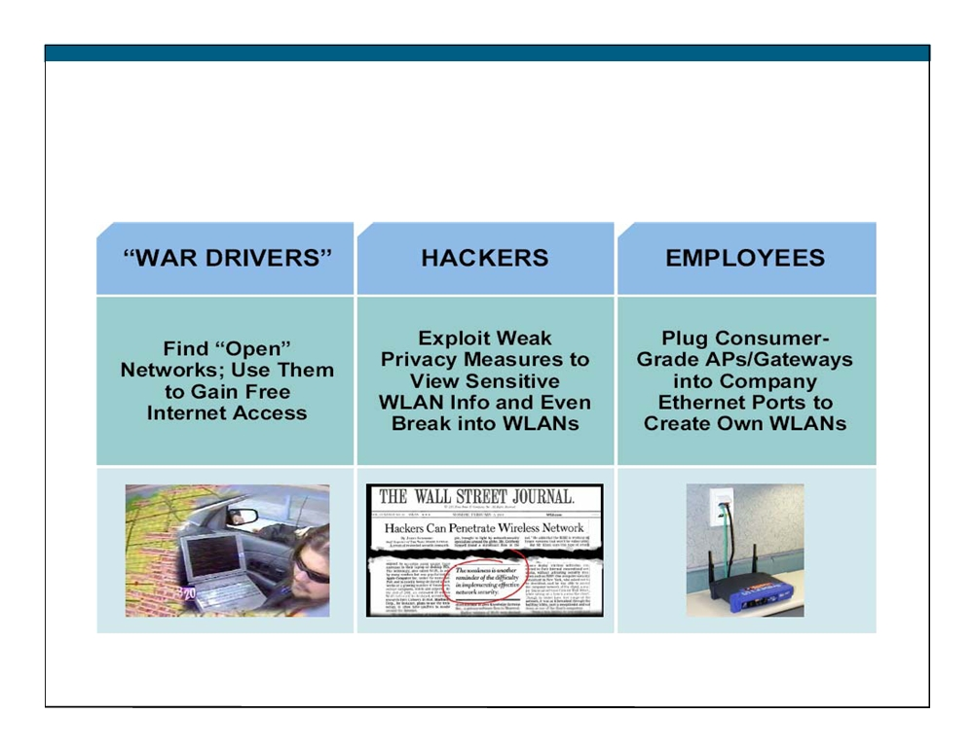
Wireless LAN Security Threats
© 2007 Cisco Systems, Inc. All rights reserved.
ICND1 v1.0—3-2
The PDF files and any printed representation for this material are the property of Cisco Systems, Inc., for the sole use by Cisco employees for personal study. The files or printed representations may not be used in commercial training, and may not be distributed for purposes other than individual self-study.

Slide 14
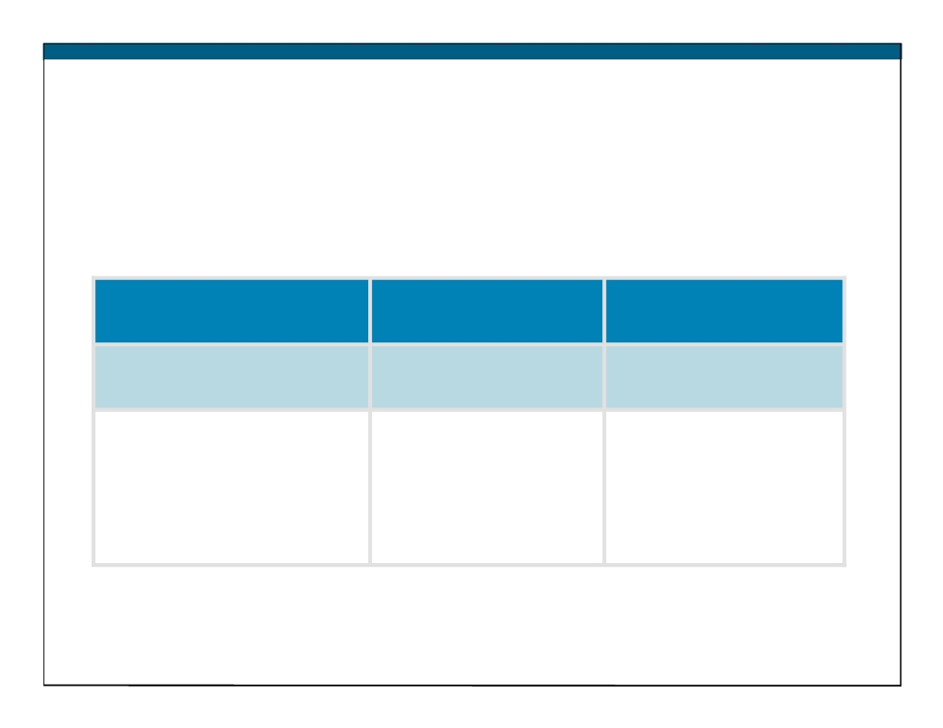
Mitigating the Threats
Control and Integrity
Privacy and
Protection and
Confidentiality
Availability
Authentication
Encryption
Intrusion Prevention
System (IPS)
Ensure that legitimate
Protect data as it is
Track and mitigate
clients associate with
transmitted and
unauthorized access
trusted access points.
received.
and network attacks.
© 2007 Cisco Systems, Inc. All rights reserved.
ICND1 v1.0—3-3
The PDF files and any printed representation for this material are the property of Cisco Systems, Inc., for the sole use by Cisco employees for personal study. The files or printed representations may not be used in commercial training, and may not be distributed for purposes other than individual self-study.

Slide 15
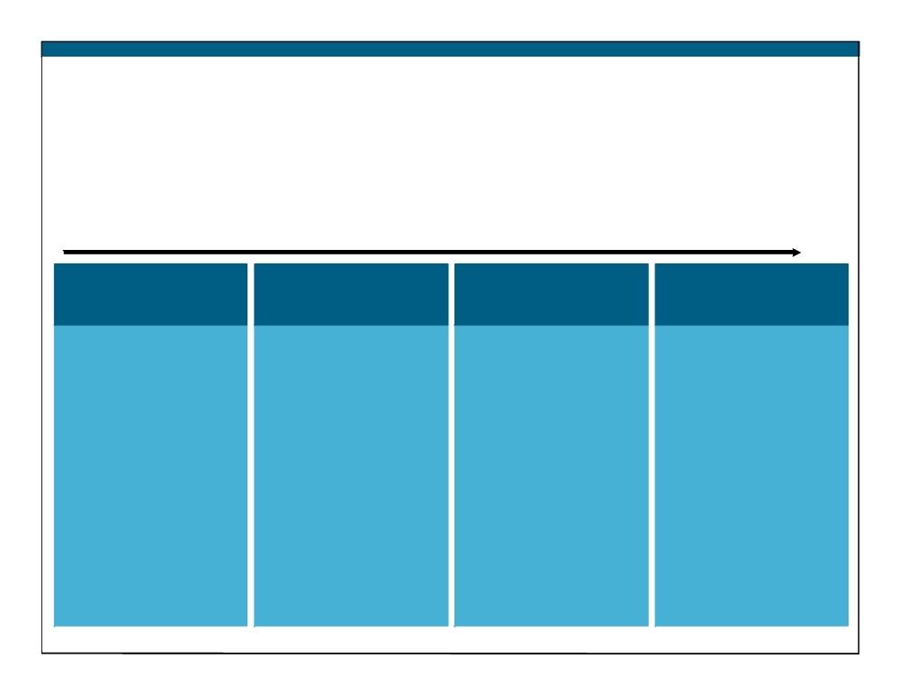
Evolution of Wireless LAN Security
1997
2001
2003
2004 to Present
WEP
802.1x EAP
WPA
802.11i / WPA2
ƒ Basic
ƒ Dynamic keys
ƒ Standardized
ƒ AES strong
encryption
ƒ Improved
ƒ Improved
encryption
ƒ No strong
encryption
encryption
ƒ Authentication
authentication
ƒ User
ƒ Strong, user
ƒ Dynamic key
ƒ Static,
authentication
authentication
management
breakable keys
ƒ 
802.1X EAP
(such as,
ƒ Not scalable
(LEAP, PEAP)
LEAP, PEAP,
EAP-FAST)
ƒ MAC filters and
ƒ RADIUS
SSID-cloaking also used to complement WEP
© 2007 Cisco Systems, Inc. All rights reserved.
ICND1 v1.0—3-4
The PDF files and any printed representation for this material are the property of Cisco Systems, Inc., for the sole use by Cisco employees for personal study. The files or printed representations may not be used in commercial training, and may not be distributed for purposes other than individual self-study.

Slide 16
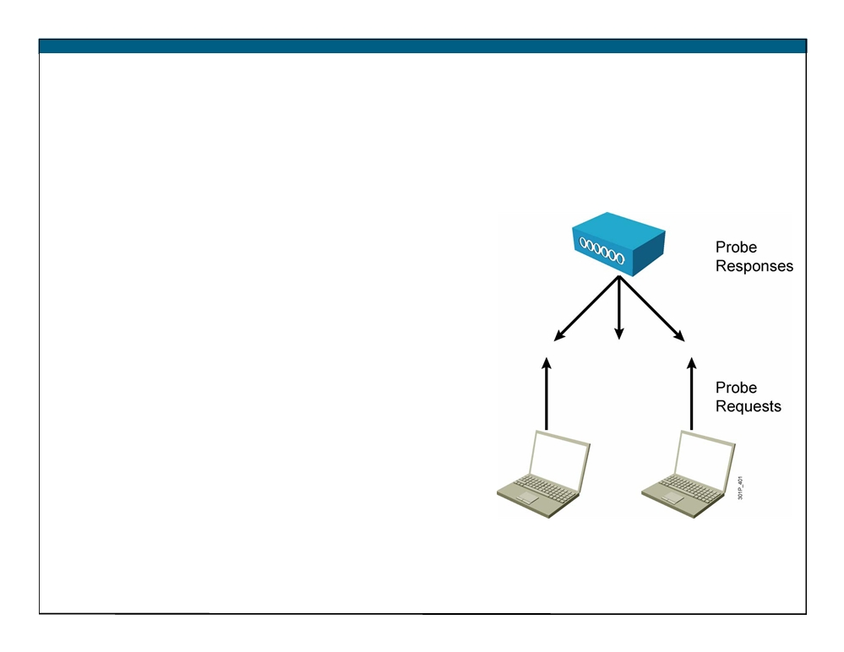
Wireless Client Association
ƒ Access points send out beacons
announcing SSID, data rates, and other information.
ƒ Client scans all channels.
ƒ Client listens for beacons and responses from access points.
ƒ Client associates to access point with strongest signal.
ƒ Client will repeat scan if signal becomes low to reassociate to another access point (roaming).
ƒ During association, SSID, MAC address, and security settings are sent from the client to the access point and checked by the access point.
© 2007 Cisco Systems, Inc. All rights reserved.
ICND1 v1.0—3-5
The PDF files and any printed representation for this material are the property of Cisco Systems, Inc., for the sole use by Cisco employees for personal study. The files or printed representations may not be used in commercial training, and may not be distributed for purposes other than individual self-study.

Slide 17
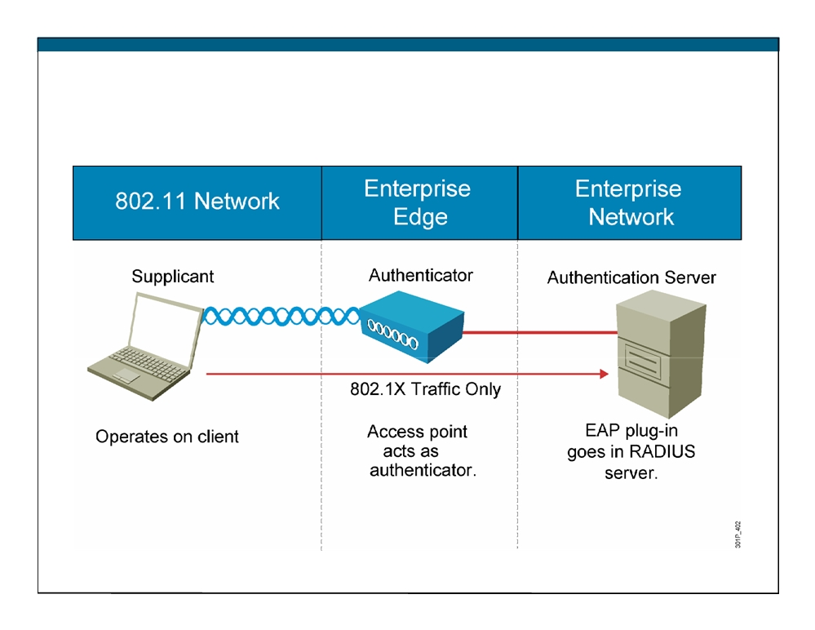
How 802.1X Works on the WLAN
© 2007 Cisco Systems, Inc. All rights reserved.
ICND1 v1.0—3-6
The PDF files and any printed representation for this material are the property of Cisco Systems, Inc., for the sole use by Cisco employees for personal study. The files or printed representations may not be used in commercial training, and may not be distributed for purposes other than individual self-study.

Slide 18
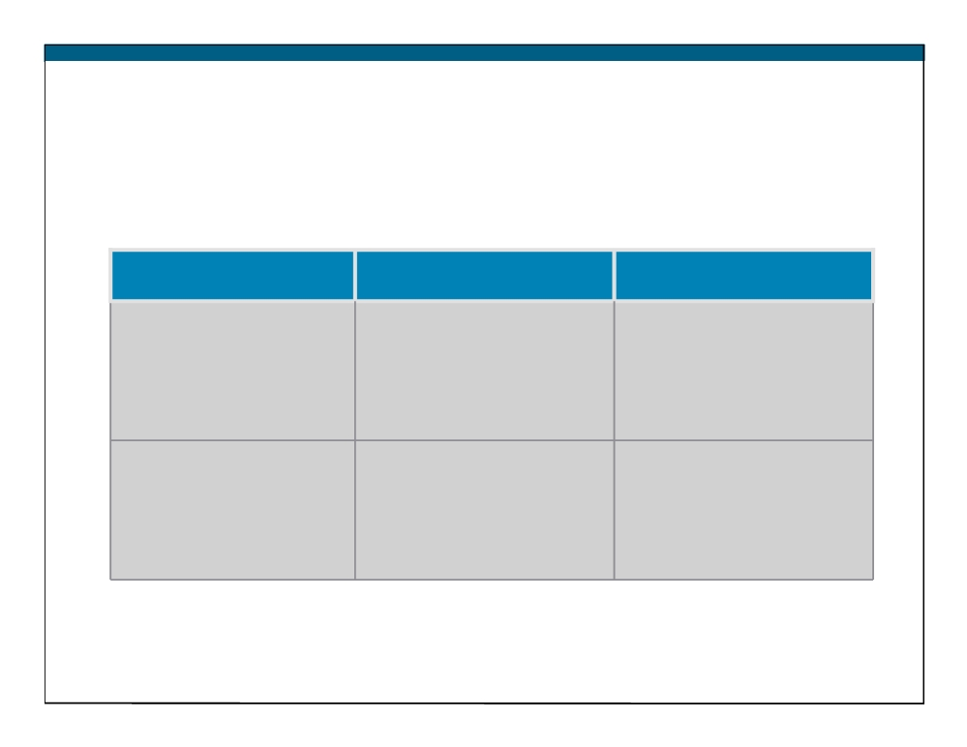
WPA and WPA2 Modes
WPA
WPA2
Enterprise mode
Authentication:
Authentication:
(Business, education,
IEEE 802.1X/EAP
IEEE 802.1X/EAP
Government)
Encryption:
Encryption:
TKIP/MIC
AES-CCMP
Personal mode
Authentication:
Authentication:
(SOHO, home and
PSK
PSK
personal)
Encryption:
Encryption:
TKIP/MIC
AES-CCMP
© 2007 Cisco Systems, Inc. All rights reserved.
ICND1 v1.0—3-7
The PDF files and any printed representation for this material are the property of Cisco Systems, Inc., for the sole use by Cisco employees for personal study. The files or printed representations may not be used in commercial training, and may not be distributed for purposes other than individual self-study.

Slide 19
Summary
ƒ It is inevitable that hackers will attack unsecured WLANs.
ƒ The fundamental solution for wireless security is authentication and encryption to protect wireless data transmission.
ƒ WLAN standards evolved to provide more security.
- WEP
-802.1x EAP
- WPA
-802.11i/WPA2
ƒ Access points send out beacons announcing SSIDs, data rates, and other information.
© 2007 Cisco Systems, Inc. All rights reserved.
ICND1 v1.0—3-8
The PDF files and any printed representation for this material are the property of Cisco Systems, Inc., for the sole use by Cisco employees for personal study. The files or printed representations may not be used in commercial training, and may not be distributed for purposes other than individual self-study.

Slide 20
Summary (Cont.)
ƒ With 802.1X, the access point, acting as the authenticator at the enterprise edge, allows the client to associate using open authentication.
ƒ WPA provides authentication support via IEEE 802.1X and PSK.
- Enterprise mode is a term given to products that are tested to be interoperable in both PSK and IEEE 802.1x/EAP modes of operation for authentication.
- Personal mode is a term given to products tested to be interoperable in the PSK-only mode of operation for authentication.
© 2007 Cisco Systems, Inc. All rights reserved.
ICND1 v1.0—3-9
The PDF files and any printed representation for this material are the property of Cisco Systems, Inc., for the sole use by Cisco employees for personal study. The files or printed representations may not be used in commercial training, and may not be distributed for purposes other than individual self-study.

Slide 21
ICND1 v1.0—3-10 The PDF files and any printed representation for this material are the property of Cisco Systems, Inc., for the sole use by Cisco employees for personal study. The files or printed representations may not be used in commercial training, and may not be distributed for purposes other than individual self-study.
© 2007 Cisco Systems, Inc. All rights reserved.

Slide 22
Implementing a WLAN
Wireless LANs
© 2007 Cisco Systems, Inc. All rights reserved.
ICND1 v1.0—-3-1
The PDF files and any printed representation for this material are the property of Cisco Systems, Inc., for the sole use by Cisco employees for personal study. The files or printed representations may not be used in commercial training, and may not be distributed for purposes other than individual self-study.

Slide 23
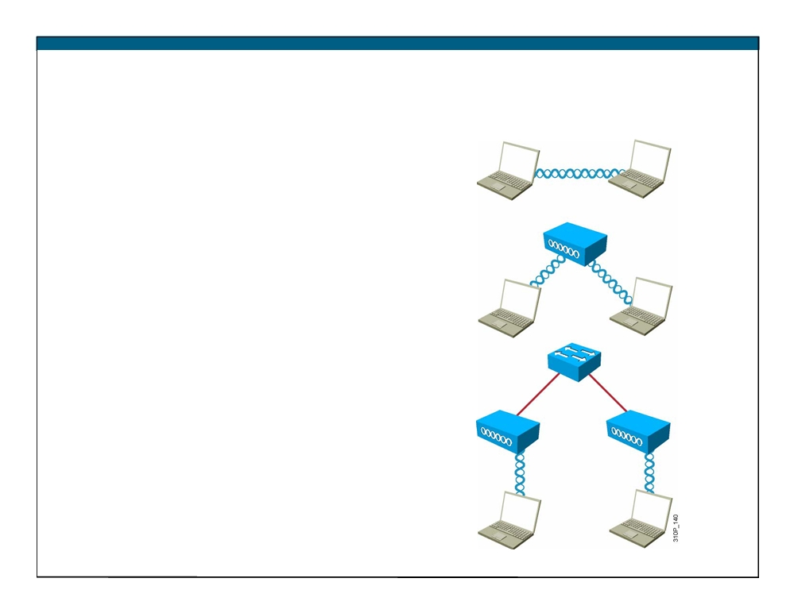
802.11 Topology Building Blocks
Ad hoc mode:
ƒ Independent Basic Service Set (IBSS)
- Mobile clients connect directly without an intermediate access point.
Infrastructure mode:
ƒ Basic Service Set (BSS)
- Mobile clients use a single access point for connecting to each other or to wired network resources.
ƒ Extended Service Set (ESS):
- Two or more BSSs are
connected by a common distribution system .
© 2007 Cisco Systems, Inc. All rights reserved.
ICND1 v1.0—3-2
The PDF files and any printed representation for this material are the property of Cisco Systems, Inc., for the sole use by Cisco employees for personal study. The files or printed representations may not be used in commercial training, and may not be distributed for purposes other than individual self-study.

Slide 24
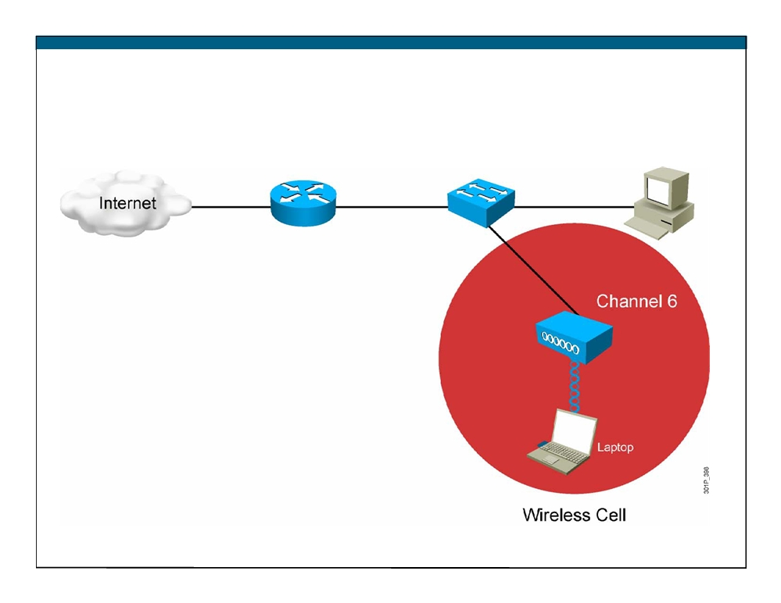
BSA Wireless Topology— Basic Coverage
© 2007 Cisco Systems, Inc. All rights reserved.
ICND1 v1.0—3-3
The PDF files and any printed representation for this material are the property of Cisco Systems, Inc., for the sole use by Cisco employees for personal study. The files or printed representations may not be used in commercial training, and may not be distributed for purposes other than individual self-study.

Slide 25
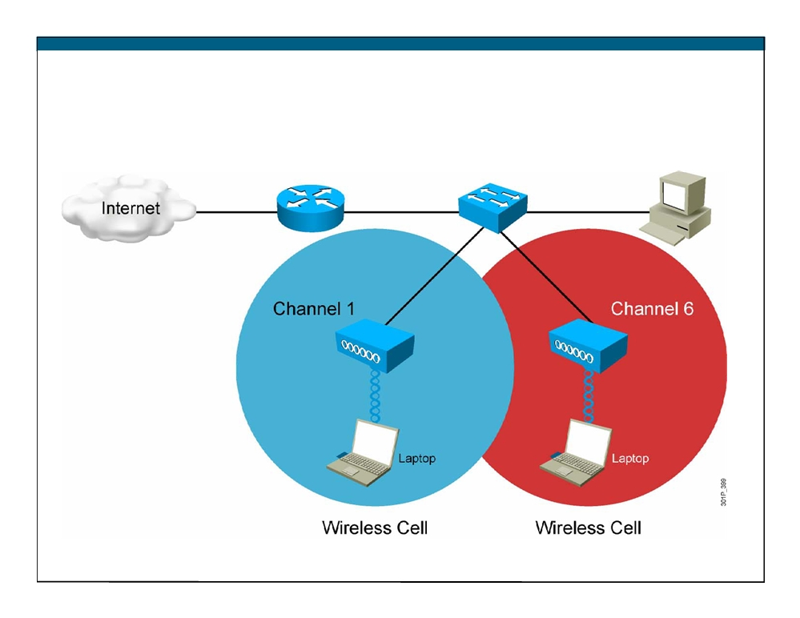
ESA Wireless Topology— Extended Cover
© 2007 Cisco Systems, Inc. All rights reserved.
ICND1 v1.0—3-4
The PDF files and any printed representation for this material are the property of Cisco Systems, Inc., for the sole use by Cisco employees for personal study. The files or printed representations may not be used in commercial training, and may not be distributed for purposes other than individual self-study.

Slide 26
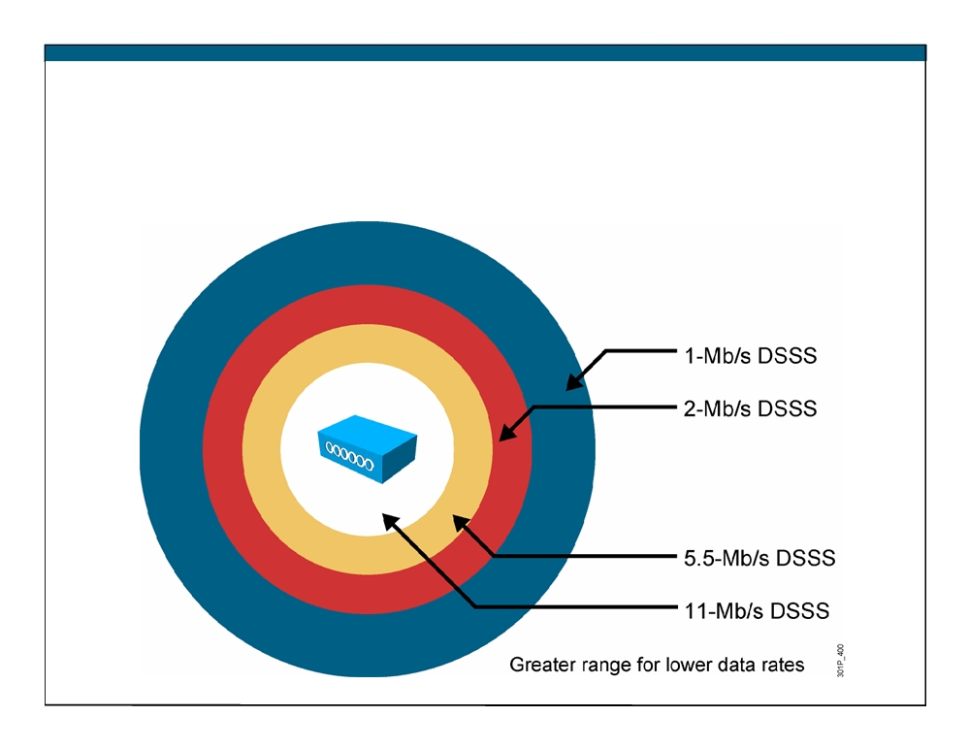
Wireless Topology Data Rates—802.11b
© 2007 Cisco Systems, Inc. All rights reserved.
ICND1 v1.0—3-5
The PDF files and any printed representation for this material are the property of Cisco Systems, Inc., for the sole use by Cisco employees for personal study. The files or printed representations may not be used in commercial training, and may not be distributed for purposes other than individual self-study.

Slide 27
Access Point Configuration
Basic parameters:
ƒ IP address (static or using DHCP), subnet mask, and default gateway
 Wireless protocol (802.11g only, 802.11a/b/g, 802.11a)
 Channel adjustment if needed—channel 1,6, or 11 pending interference
 Power adjustment if needed—or could change antenna Security parameters:
 Service Set Identifier (SSID)—identifies your network
 Authentication method—usually WPA or WPA2 PSK
 Encryption method—usually TKIP, or AES if hardware-supported
© 2007 Cisco Systems, Inc. All rights reserved.
ICND1 v1.0—3-6
The PDF files and any printed representation for this material are the property of Cisco Systems, Inc., for the sole use by Cisco employees for personal study. The files or printed representations may not be used in commercial training, and may not be distributed for purposes other than individual self-study.

Slide 28
Steps to Implement a Wireless Network
Step 1: Verify local wired operation—DHCP and ISP.
Step 2: Install the access point.
Step 3: Configure the access point—SSID, no security.
Step 4: Install one wireless client—no security.
Step 5: Verify wireless network operation.
Step 6: Configure wireless security—WPA with PSK. Step 7: Verify the wireless network operation.
© 2007 Cisco Systems, Inc. All rights reserved.
ICND1 v1.0—3-7
The PDF files and any printed representation for this material are the property of Cisco Systems, Inc., for the sole use by Cisco employees for personal study. The files or printed representations may not be used in commercial training, and may not be distributed for purposes other than individual self-study.

Slide 29
Wireless Clients
Wireless Zero Configuration (WZC):
ƒ Default on Windows XP or later operating system
ƒ Limited features for basic PSK
ƒ Verify that users have the correct encryption type and password Cisco Compatible Extensions Program
ƒ Accelerated feature deployment of third-party clients
ƒ Wide deployment of various vendors
Cisco Secure Services Client
ƒ Enterprise full-featured wireless client supplicant
ƒ Wired and wireless
© 2007 Cisco Systems, Inc. All rights reserved.
ICND1 v1.0—3-8
The PDF files and any printed representation for this material are the property of Cisco Systems, Inc., for the sole use by Cisco employees for personal study. The files or printed representations may not be used in commercial training, and may not be distributed for purposes other than individual self-study.

Slide 30
Common Wireless Network Issues
Most problems are due to incorrect configuration:
ƒ Verify that the access point is running the latest revision of firmware.
ƒ Verify the channel configuration. Try channels 1, 6, or 11.
ƒ Verify that users have the correct encryption type and password. Other common problems:
ƒ RF interference
ƒ Not connected
ƒ Radio not enabled
ƒ Poor antenna location
© 2007 Cisco Systems, Inc. All rights reserved.
ICND1 v1.0—3-9
The PDF files and any printed representation for this material are the property of Cisco Systems, Inc., for the sole use by Cisco employees for personal study. The files or printed representations may not be used in commercial training, and may not be distributed for purposes other than individual self-study.

Slide 31
Wireless Troubleshooting
ƒ Locate the access point near the center of your home or office.
ƒ Avoid mounting the access point next to metal objects.
ƒ Keep the access point out of the line of sight of devices that contain metal.
ƒ Verify connectivity without the security of PSK.
ƒ Avoid RF interference from other equipment (gaming, monitors, phones).
ƒ If the home or office is large, you may need two or more access points.
ƒ Make sure the access point works over a unique channel not in use by other adjacent access point deployments.
© 2007 Cisco Systems, Inc. All rights reserved.
ICND1 v1.0—3-10
The PDF files and any printed representation for this material are the property of Cisco Systems, Inc., for the sole use by Cisco employees for personal study. The files or printed representations may not be used in commercial training, and may not be distributed for purposes other than individual self-study.

Slide 32
Summary
ƒ 802.11 topologies operate in various modes: - In ad hoc mode, clients connect directly without an intermediate access point.
- In infrastructure mode, clients connect through an access point. There are two submodes, Basic Service Set (BSS) and Extended Service Set (ESS).
ƒ BSS wireless topology consists of the basic service area (BSA) and the extended service area (ESA).
© 2007 Cisco Systems, Inc. All rights reserved.
ICND1 v1.0—3-11
The PDF files and any printed representation for this material are the property of Cisco Systems, Inc., for the sole use by Cisco employees for personal study. The files or printed representations may not be used in commercial training, and may not be distributed for purposes other than individual self-study.

Slide 33
Summary (Cont.)
ƒ Wireless access points can be configured through a CLI or, more commonly, a browser GUI.
ƒ The basic approach to wireless implementation is to gradually configure and test incrementally.
ƒ Currently there are many form factors available to add wireless to laptops:
- Wireless Zero Configuration - Cisco Compatible Extensions - Cisco Secure Services Client
ƒ You can troubleshoot wireless by breaking the environment into the wired network and the wireless network.
ƒ WLAN data rates are affected by standards, access point placement, and distances.
© 2007 Cisco Systems, Inc. All rights reserved.
ICND1 v1.0—3-12
The PDF files and any printed representation for this material are the property of Cisco Systems, Inc., for the sole use by Cisco employees for personal study. The files or printed representations may not be used in commercial training, and may not be distributed for purposes other than individual self-study.

Slide 34
ICND1 v1.0—3-13 The PDF files and any printed representation for this material are the property of Cisco Systems, Inc., for the sole use by Cisco employees for personal study. The files or printed representations may not be used in commercial training, and may not be distributed for purposes other than individual self-study.
© 2007 Cisco Systems, Inc. All rights reserved.

Slide 35
Module Summary
ƒ The various 802.11 standards identify the characteristics of the transmissions used by WLANs, while WI-Fi Certification ensures compatibility between devices.
ƒ To address common threats to WLAN services, security has evolved to include 802.1x and WPA.
ƒ Wireless implementations are affected by distance, speed, and form factors.
© 2007 Cisco Systems, Inc. All rights reserved.
ICND1 v1.0—3-1
The PDF files and any printed representation for this material are the property of Cisco Systems, Inc., for the sole use by Cisco employees for personal study. The files or printed representations may not be used in commercial training, and may not be distributed for purposes other than individual self-study.

Slide 36
ICND1 v1.0—3-2 The PDF files and any printed representation for this material are the property of Cisco Systems, Inc., for the sole use by Cisco employees for personal study. The files or printed representations may not be used in commercial training, and may not be distributed for purposes other than individual self-study.
© 2007 Cisco Systems, Inc. All rights reserved.

